Slide 1
PPI analysis for Brain Voyager QX (developed in version BVQX2.4) Based on: Friston et al, 1997 O’reilly et al, 2012 Cisler et al 2014 Gilam et al 2015 If you use this script please cite: Gilam et al, 2015, Neuroimage

Slide 2
Some initial theoretical considerations:
PPI analysis is a technique for investigating task-specific changes in functional connectivity, defined as task-specific changes in the relationship between brain areas.
PPI analyses tend to lack power and hence a high proportion of false negatives should be expected.
PPI relies on modeling the interaction between a psychological context and brain activity. A problem arises because while the psychological context is measured in real time, brain activity is measured with a lag of ∼6 s and with temporal blurring, due to convolution with the hemodynamic response function. To combine the two time-series, both need to be convolved with the HRF, or both need to be expressed in terms of the underlying neural activity (deconvolved). The implementation of PPI in FSL uses the first approach (so do we in this implementation for BV) while the implementation in SPM uses the second.
It may be particularly difficult to use PPI in experiments with event-related designs: first, the shape of the HRF and assumptions about it are more important in the context of event-related designs. Secondly, as PPI analyses tend to lack power and event-related designs tend to have smaller effect sizes than block designs (due to a smaller proportion of the task time being spent in the condition of interest), spurious null results may be even more likely for PPIs in event-related designs that PPIs in block designs.
Usually people tend to count more on positive PPI results rather than negative because of difficulties in interpretation*. This however is not always true in regards to what you may find in actual publications.
Notes:
*PPI is in fact multiple linear regression in which we test whether the difference in slopes (Beta_2-Beta_1) between two tasks is greater than zero on average across our group of subjects. If we get a negative Z-score for the difference in slope, it means that Beta_2-Beta_1 is significantly negative. That could mean two things: (A) that Beta_1 and Beta_2 are both negative, with Beta_1 having a greater absolute value (i.e. activity in the 'new' ROI is negatively related to activity in the seed ROI, and this relationship is stronger during the task); (B) But it could also mean that Beta_1 and Beta_2 are both positive and Beta_2 is bigger than Beta_1 (ie, there is a +ve relationship between activity in the new ROI and seed ROI, that gets weaker during the task blocks).
Unfortunately since you are always testing the relative strength of relationships, it is difficult to distinguish between these two interpretations. Possibly you could do this by looking at whether the regression of activity in the new ROI on the seed ROI is positive in general (ie whether you get a positive Z score for the effect of the regressor just capturing seed ROI activity without task modulation). If this is negative, it would favor explanation A, whereas if positive, it would favor B. However, there remains the possiibility that Beta_1 and Beta_2 have different signs which would probably mean a different interpretation all together...

Slide 3
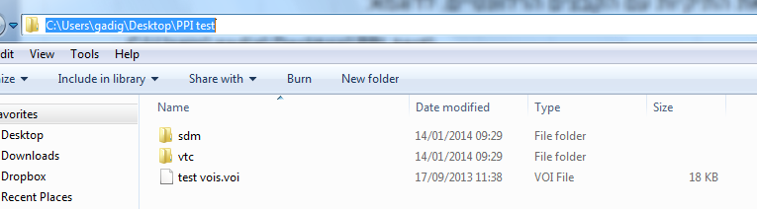
Prepare directories with the relevant files. E.g.:
VTC directory:
SDM directory (experimental task predictors):
VOI file with the potential “seed regions” for the analysis:
C:\Users\gadig\Desktop\PPI test\
C:\Users\gadig\Desktop\PPI test\vtc\
C:\Users\gadig\Desktop\PPI test\sdm\
C:\Users\gadig\Desktop\PPI test\test vois.voi

Slide 4
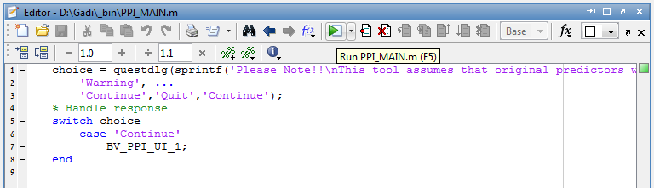
2. Make sure that the BVQX_tools is part of the matlab path:
3. Run in matlab the PPI_MAIN.m file

Slide 5
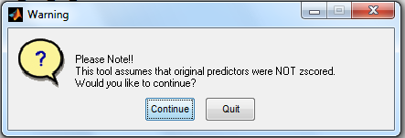
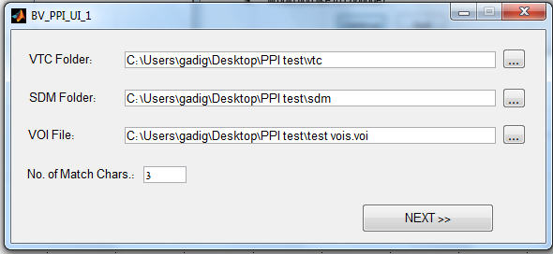
4. The script Z-transforms that predictors as part of the procedure, therefore you will receive a prompt reminding you to use SDM files in which the predictors were not already z-scored (required for an accurate PPI analysis)
5. Next you will be asked to populate the exact location of the files:

Slide 6
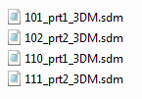

6. Note the “match chars” field – it refers to the number of characters at the beginning of each VTC and SDM file that uniquely describes each participant. This is according to the standard naming convention of BV.
In the following example, we need 3 chars to confirm the relationship between the VTCs and the SDMs
Important – if a certain VTC file has more than one SDM file that matches, an error prompt will pop up and the script will stop.
A VTC file with no matching SDM will not be included in the script.

Slide 7
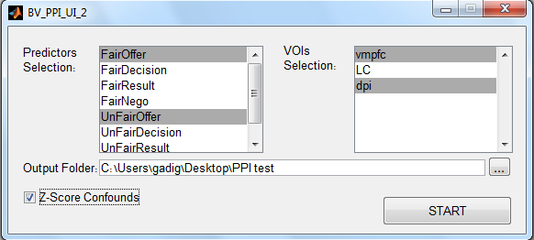
7. Final phase:
a. choose only the relevant predictors for the analysis (sometimes too many predictors may cause a problem of multiple-collinearity).
b. choose the ROIs for which you want to generate the PPI SDMs (each one will be a separate SDM and therefore a separate GLM).
c. provide an output folder
d. if the original SDM included any confound predictors (e.g. movement parameters..) then you can and it is suggested to z-score them as well.
8. To run the script, press START

Slide 8
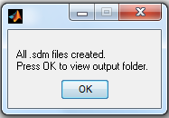
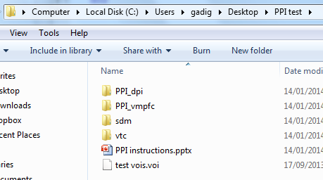
9. The message that the script ended successfully:
10. A new directory was created for each VOI separately:

Slide 9
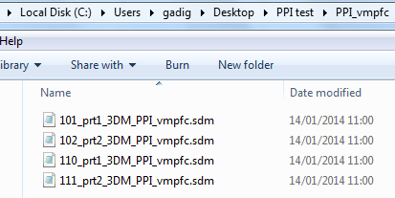
11. The new SDM files were saved with the same naming scheme as the original SDMs, but with the additional of PPI and the VOI name at the end:
12. Next, create a new MDM with the original VTCs and the new PPI SDMs and generate a new GLM which will show you the PPI map from the VOI.
Good luck!!
Gadi Gilam
gadi.gilam@gmail.com
gadi.gilam@Stanford.edu
If you use this script please cite: Gilam et al, 2015, Neuroimage

